Slide 1
Employee Data Analysis using Excel
STUDENT NAME: SHARMILA S
REGISTER NO:FC5E44B20D1DCF08C0B4B34B55B2D993E,312208775
DEPARTMENT: B.COM[GENERAL]
COLLEGE: MEENAKSHI COLLEGE FOR WOMEN

Slide 2
PROJECT TITLE
Employee Performance Analysis
Based on Department type , Gender , FTE using Excel

Slide 3


AGENDA
Problem Statement
Project Overview
End Users
Our Solution and Proposition
Dataset Description
Modelling Approach
Results and Discussion
Conclusion
3/21/2024 Annual Review

Slide 4

PROBLEM STATEMENT
Full Time Equivalent (FTE) provides a standardized measure of workforce capacity, allowing for accurate comparisons of employee contributions regardless of individual work hours. It helps in budgeting and financial planning by quantifying labor costs and determining staffing needs.

Slide 5

PROJECT OVERVIEW
Datasets are crucial for making informed decisions by providing accurate and relevant information. They help uncover insights, identify trends, and predict future outcomes, which enhances strategic planning. By analyzing data, organizations can optimize processes, reduce costs, and improve products or services.
.

Slide 6

WHO ARE THE END USERS?
● HUMAN RESOURCE DEPARTMENTS
● MANAGEMENT AND LEADERSHIP
● TEAM LEADERS AND SUPERVISORS
● EMPLOYEES
● EXECUTIVE LEADERSHIP
● BUSINESS ANALYSTS
● RECRUITERS

Slide 7

OUR SOLUTION AND ITS VALUE PROPOSITION
FILTERING- REMOVE VALUES
PIVOT TABLE - SUMMARY OF
EMPLOYEE PERFORMANCE
BAR DIAGRAM - FINAL REPORT

Slide 8
Dataset Description
● EMPLOYEE DATA SET- NAN MUDHALVAN PORTAL
● 9 FEATURES IN EXCEL:
EMPLOYEE ID- ALPHANUMERIC(TEXT)
NAME- ALPHABETICAL(TEXT)
GENDER- ALPHABETICAL(TEXT)
DEPARTMENT - ALPHABETICAL(TEXT)
SALARY - NUMERICAL
START DATE - ALPHANUMERIC(TEXT)
FTE- NUMERICAL
EMPLOYEE TYPE- ALPHABETICAL(TEXT)
EMPLOYEE LOCATION- ALPHABETICAL(TEXT)
● 3 FEATURES USED:
DEPARTMENT - ALPHABETICAL(TEXT)
FTE- NUMERICAL
GENDER- ALPHABETICAL(TEXT)

Slide 9

THE "WOW" IN OUR SOLUTION
Additionally, datasets enable personalized experiences, boosting customer satisfaction. They are also fundamental in research and development, advancing knowledge and fostering innovation. Overall, datasets support efficient operations and effective performance evaluation.
3/21/2024 Annual Review
9

Slide 10
MODELLING
● STEP -1
DOWNLOAD THE EMPLOYEE DATASET
AND OPEN THE EMPLOYEE DATASET IN EXCEL.
● STEP -2
SELECT THE ENTIRE DATA AND CLICK
ON DATA AND CLICK ON FILTER OPTION.
● STEP -3
FILTER FTP FROM A TO Z ORDER.
● STEP -4
SELECT THE ENTIRE DATA AND CLICK
ON INSERT AND CLICK ON PIVOT TABLE TO
CREATE PIVOT TABLE.
10

Slide 11
● STEP -5
DRAG THE NEEDED DATA AND CREATE A
PIVOT TABLE.
● STEP -6
SELECT THE PIVOT TABLE AND CLICK ON
INSERT.
● STEP-7
NOW CLICK ON THE CHART THAT YOU
WANT.
● STEP -8
THE CHART IS CREATED

Slide 12
RESULTS
1.TABLE
Sum of FTE | Column Labels
Row Labels | Accounting | Business Development | Human Resources | Legal | Grand Total
Female | 6.6 | 7.9 | 4.3 | 6.3 | 25.1
Male | 8.9 | 12 | 3.6 | 9.5 | 34
(blank) | 0.9 |  | 2 | 1 | 3.9
Grand Total | 16.4 | 19.9 | 9.9 | 16.8 | 63
12

Slide 13
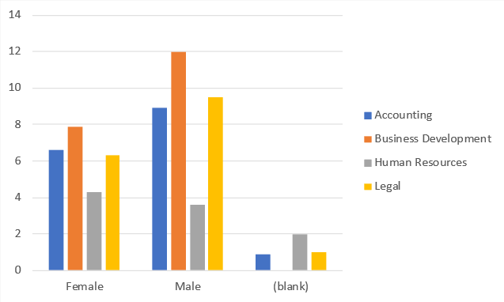
2. BAR DIAGRAM

Slide 14
conclusion
In conclusion, datasets are indispensable tools that enable organizations and researchers to make data-driven decisions, uncover valuable insights, and drive strategic initiatives. They facilitate predictive analytics, optimize processes, and enhance product and service development.

